Slide 1

Leidos Pride ERG
DMV Chapter Launch!
Welcome Everyone
Presented By:
Brendan McCullagh &
Olivia DAliberti
Notes:
We should consider playing some music while waiting for everyone to get started. Maybe - “I’m Coming Out” by Diana Ross?
https://www.youtube.com/watch?v=F-mjl63e0ms&ab_channel=MarinLjubi%C4%87
Brendan to add content and update template format
Reach out to Dars again for Sponsor Convo piece
Brendan to create polls
Tuesday evening - Liv to do cleanup & send to JB

Slide 2
Welcome! Thanks for Coming Out
Tell us why you’re here today!
*Write in the WebEx Chat!*
Liv: “I’m here because I want to create local queer community here at Leidos!”
Brendan: “I’m here because I want to plan engaging events to bring the Leidos LGBTQIA+ & allied community together across contracts and corporate!”

Slide 3
Who are We? What’s our Deal?
We are the Pride ERG’s brand new DMV Chapter - a Pride group within Leidos specifically focused on programming within the District of Columbia, Maryland, and Virginia!
We are about supporting the LGBTQIA+ Community in the DMV and creating opportunities for Queer Networking within Leidos. In practice, that means that we are committed to holding monthly events for Leidos employees and working to organize leidos employees around local LGBTQIA+ movements.
We want to build YOUR career at Leidos and OUR DMV LGBTQIA+ community.

Slide 4
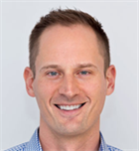
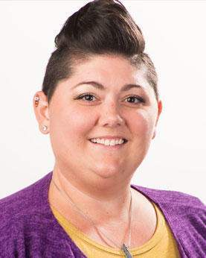
A Message from Our Pride ERG Board
Chair
Robert Brumfield
Chapter Manager
JB Bradley

Slide 5
Our Values
We are all about #inclusion and #diversity
In practice, that means that we actively support ALL employees in the DMV and plan to partner closely with other ERGs; in particularly the African American ERG, Women’s Network ERG and Young Professionals Network ERG.
Everyone is welcome and we will actively and loudly support other causes:
#TransRights, #BLM, #RadicalFeminism, #GayAgenda

Slide 6
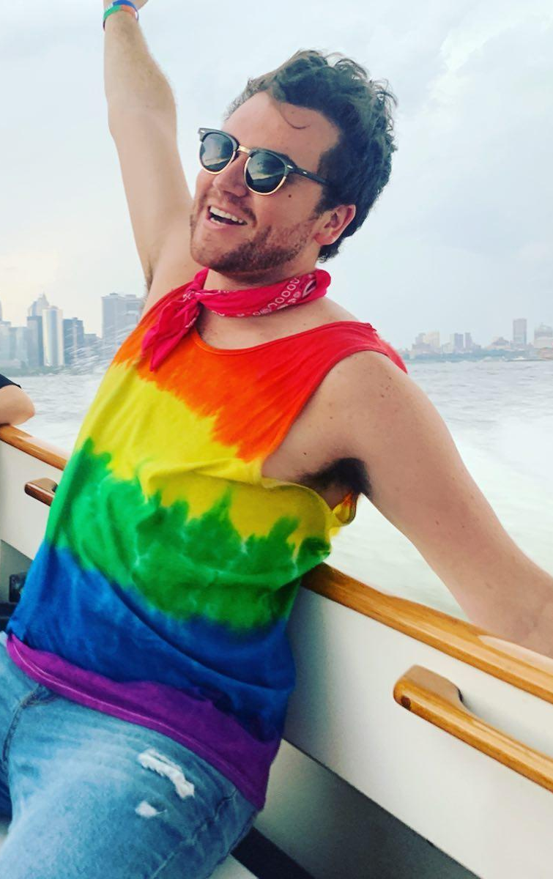
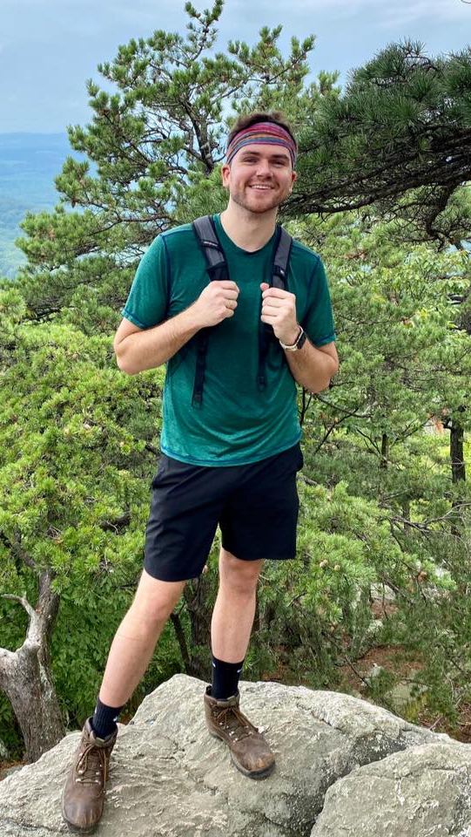
Who are We: Brendan
Pronouns: He/Him/His
Job: Financial Analyst / Lean Six Sigma Green Belt Facilitator
Location: Washington, D.C.
Interests: Queer Volleyball & Kickball, Hiking, Traveling, and Drag Shows!

Slide 7
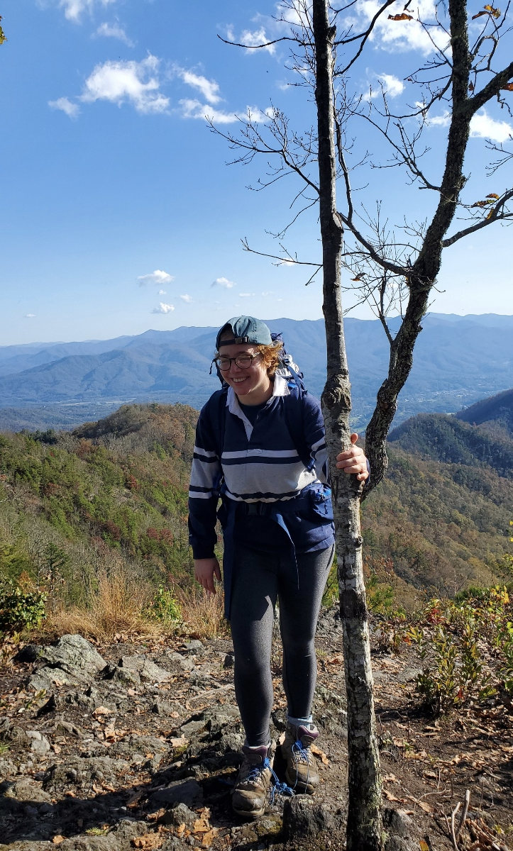
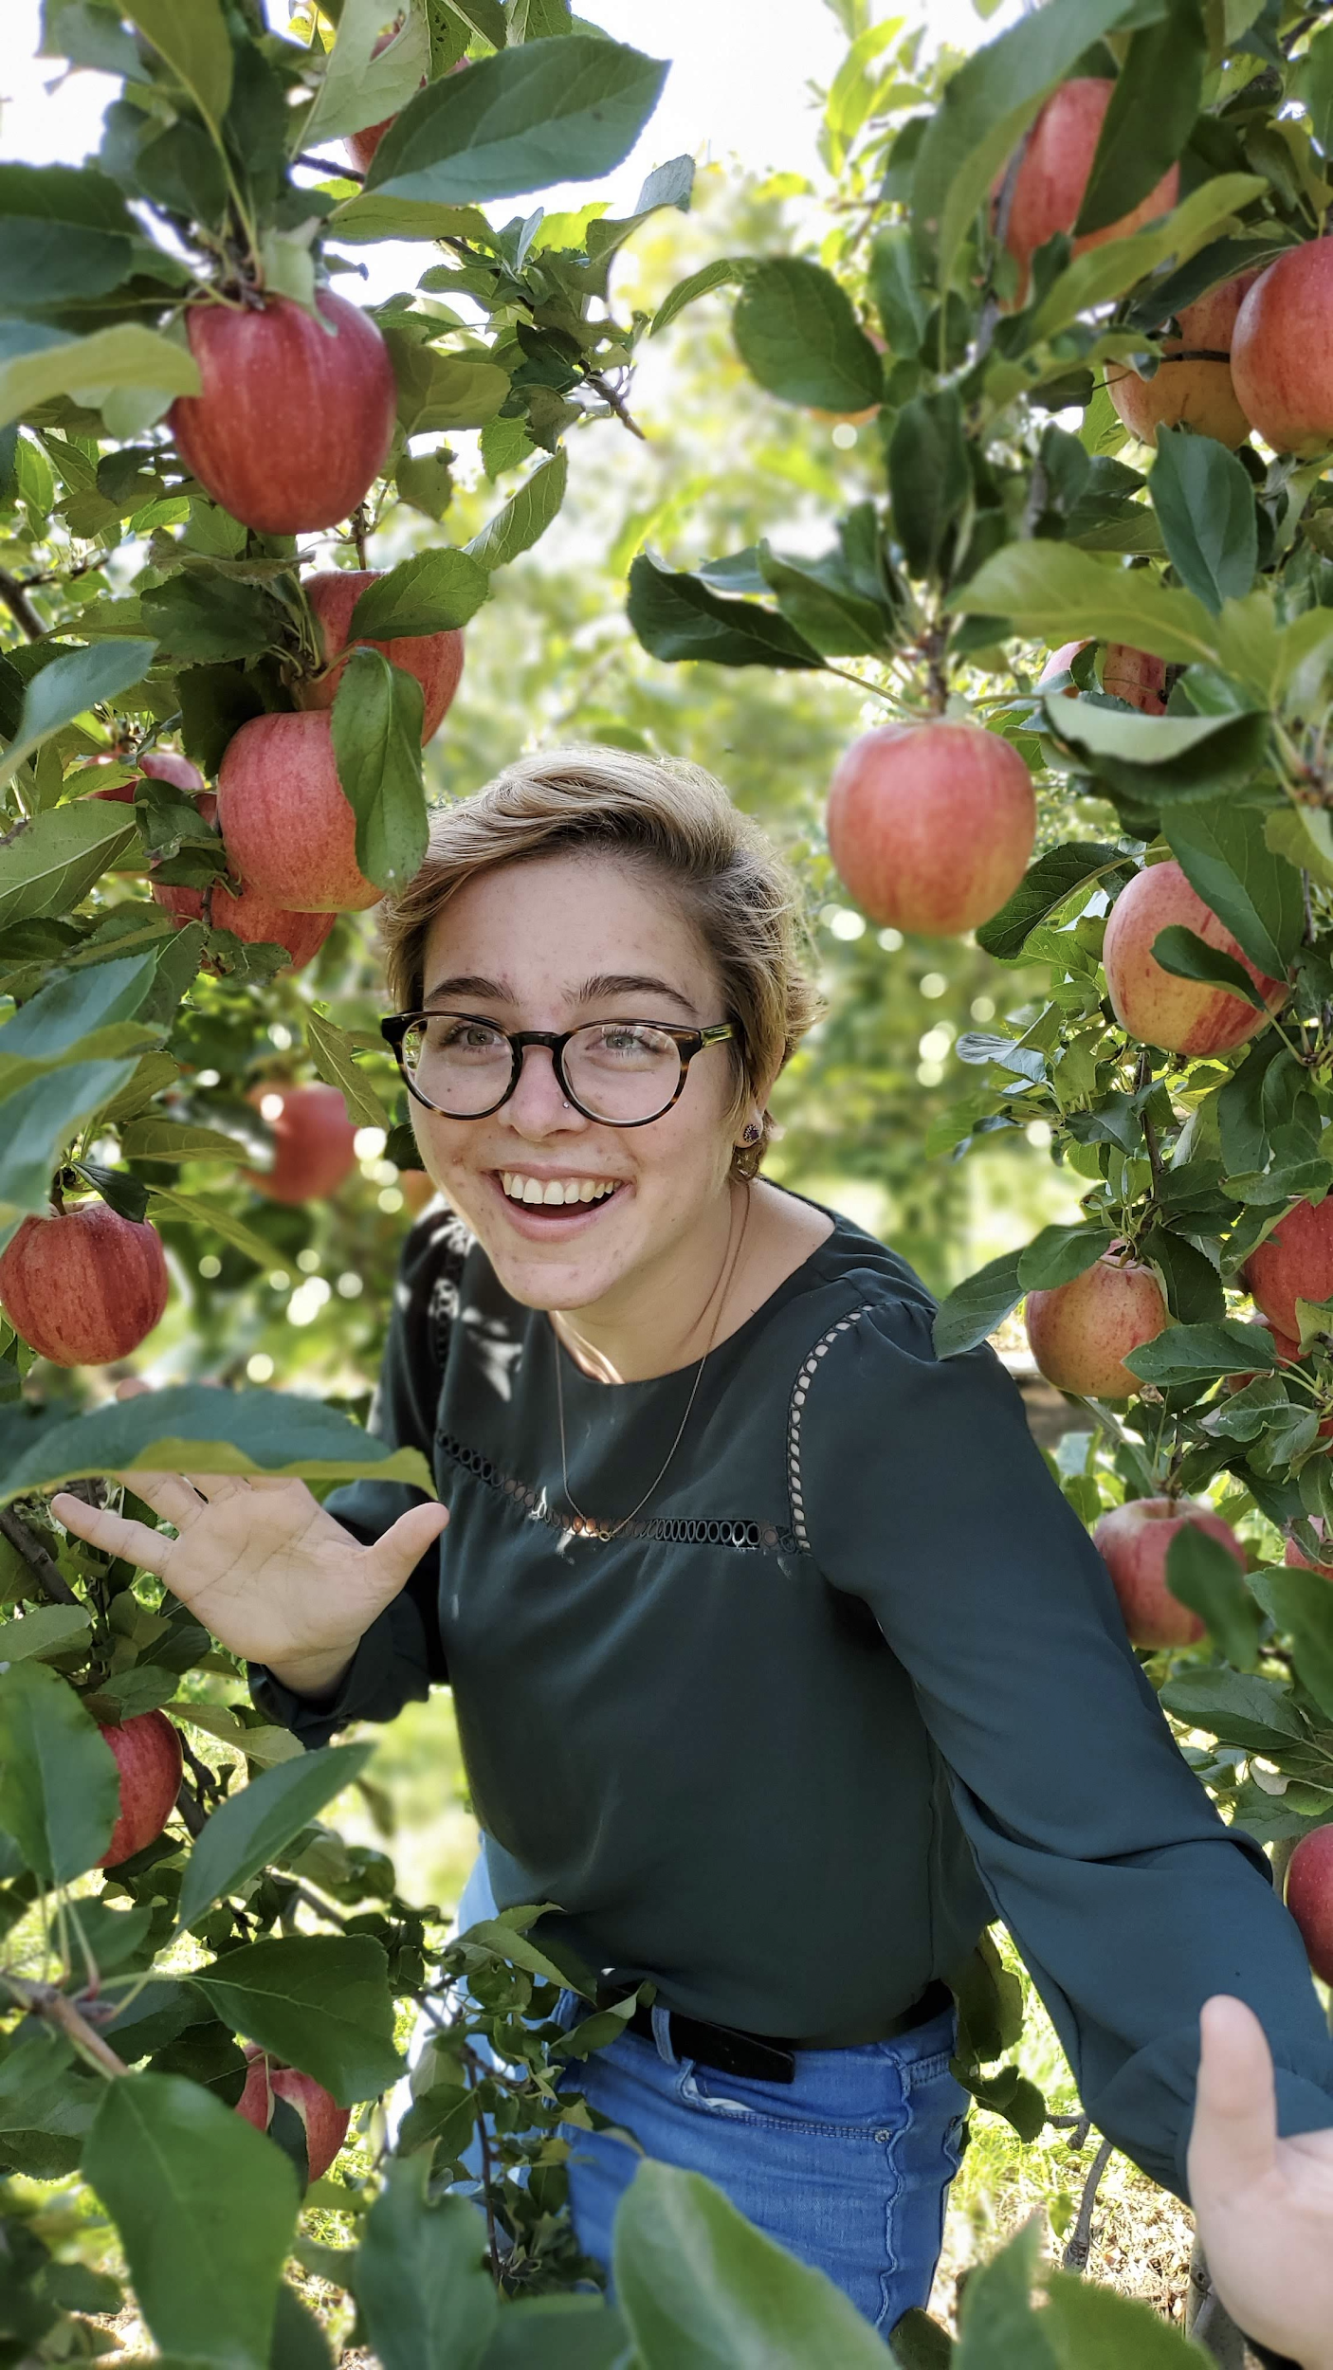
Who Are We: Liv
Pronouns: She/Her/Hers
Job: Research Data Scientist
Location: Ballston, VA
Interests: Rugby, Hiking, Other
People’s Pets and Kids

Slide 8
Who are you?
*Chat your name, position, and location!*

Slide 9
Event Polls
Our first ~official~ chapter event will December 10th, 2020.
https://www.surveymonkey.com/r/MRVMKCZ

Slide 10
#GayNews in the DMV & Beyond!
Washington Blade - 33 LGBTQ candidates win election to ANC seats across D.C.
Washington Post - Virginia poised to become first Southern state banning LGBT discrimination
Human Rights Campaign - HISTORY: Sarah McBride Becomes First Transgender State Senator
Washington Blade - New ‘blueprint’ lights way for Biden to reverse Trump policies on LGBTQ rights
New York Times - In Shift for Church, Pope Francis Voices Support for Same-Sex Civil Unions

Slide 11
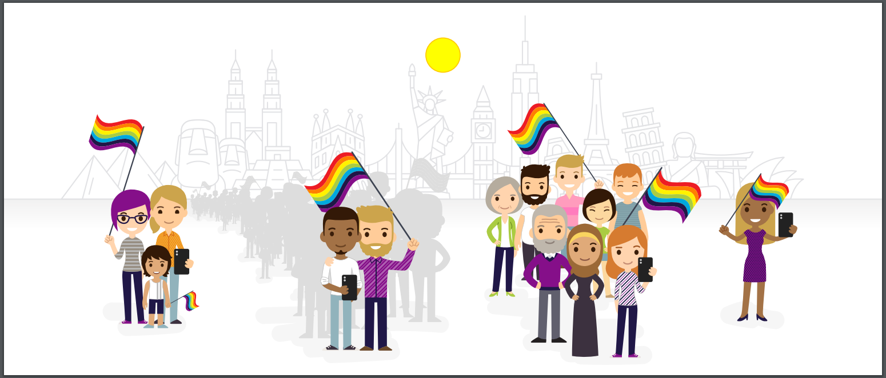
Any Questions?

Slide 12

Thank You!!!

